Slide 1
Chapter 6
Innovative EC Systems:
From E-Government and E-Learning to Consumer-to-Consumer Commerce
© 2008 Pearson Prentice Hall, Electronic Commerce 2008, Efraim Turban, et al.

Slide 2
Learning Objectives
Describe various e-government initiatives.
Describe e-learning, virtual universities, and e-training.
Describe online publishing and e-books.
Discuss wikis and blogging.
Describe knowledge management and dissemination as an e-business.
Describe C2C activities.
Describe peer-to-peer networks and applications.
8-<number>

Slide 3
E-Government: An Overview
e-government
E-commerce model in which a government entity buys or provides goods, services, or information to businesses or individual citizens
8-<number>

Slide 4
E-Government: An Overview
Several major categories fit within this broad definition of e-government:
  government-to-citizens (G2C)
  E-government category that includes all the interactions between a government and its citizens
  Government-to-business (G2B)
  Government-to-government (G2G)
  Internal Efficiency and Effectiveness (IEE)
  Government-to-employees (G2E)
8-<number>

Slide 5
E-Government: An Overview
government-to-citizens (G2C)
E-government category that includes all the interactions between a government and its citizens
electronic voting
Voting process that involves many steps ranging from registering, preparing, voting, and counting (voting and counting are all done electronically)
Netizen
A citizen surfing the Internet
Electronic benefits transfer
8-<number>

Slide 6
E-Government: An Overview
government-to-business (G2B)
E-government category that includes interactions between governments and businesses (government selling to businesses and providing them with services and businesses selling products and services to government)
8-<number>

Slide 7
E-Government: An Overview
Government-to-Business (G2B)
  Government e-procurement
  Group purchasing
  Forward e-auctions
  Tax collection and management
8-<number>

Slide 8
E-Government: An Overview
government-to-government (G2G)
E-government category that includes activities within government units and those between governments
government-to-employees (G2E)
E-government category that includes activities and services between government units and their employees
8-<number>

Slide 9
E-Government: An Overview
Government-to-Employees (G2E)
  Internal efficiency and effectiveness
    E-payroll
    E-records management
    E-training
    Enterprise case management
    Integrated acquisition
    Integrated human resources
    One-stop recruitment
Facilitating Homeland Security
8-<number>

Slide 10
Implementing E-Government
Six stages in the transformation to
e-government:
  Information publishing/dissemination
  “Official” two-way transactions with one department at a time
  Multipurpose portals
  Portal personalization
  Clustering of common services
  Full integration and enterprise transformation
8-<number>

Slide 11
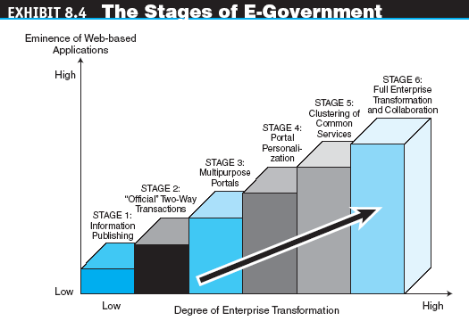
Implementing E-Government
8-<number>

Slide 12
Implementing E-Government
Implementation Issues of E-Government
  Transformation speed
  G2B implementation
  Security and privacy issues
  Wireless applications
  Business aspects
Citizen Adoption of E-Government
Non–Internet E-Government
8-<number>
Notes:
While e-government is often thought of as "online government" or "Internet-based government," many non-Internet "electronic government" technologies can be used in this context. Some non-Internet forms include telephone, fax, PDA, SMS text messaging, MMS, wireless networks and services, Bluetooth, CCTV, tracking systems, RFID, biometric identification, road traffic management and regulatory enforcement, identity cards, smart cards and other Near Field Communication applications; polling station technology (where non-online e-voting is being considered), TV and radio-based delivery of government services, email, online community facilities, newsgroups and electronic mailing lists, online chat, and instant messaging technologies.

Slide 13
INTRAbusiness
INTRAbusiness is within a company, It involves e-commerce actions that are carried out within an institution, usually through the institution’s intranet. The actions can entail the trade of products, services or information amongst workers.
8-<number>

Slide 14
E-Learning
e-learning
The online delivery of information for purposes of education, training, or knowledge management
8-<number>

Slide 15
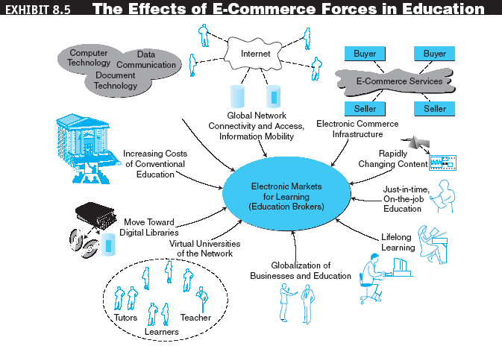
E-Learning
8-<number>

Slide 16
E-Learning
Benefits of E-Learning
  Time reduction
  Large volume and diversity
  Cost reduction
  Higher content retention
  Flexibility
  Updated and consistent material
  Fear-free environment
8-<number>

Slide 17
E-Learning
Drawbacks and Challenges of
E-Learning
  Need for instructor retraining
  Equipment needs and support services
  Lack of face-to-face interaction and campus life
  Assessment
  Maintenance and updating
  Protection of intellectual property
  Computer literacy
  Student retention
8-<number>

Slide 18
E-Learning
Why E-Learning Fails
  Believing that e-learning is always a cheaper learning or training alternative
  Overestimating what e-learning can accomplish
  Overlooking the shortcomings of self-study
  Failing to look beyond the course paradigms
  Viewing content as a commodity
  Ignoring technology tools for e-learning or fixating too much on technology as a solution
  Assuming that learned knowledge will be applied
8-<number>

Slide 19
E-Learning
distance learning
Formal education that takes place off campus, usually, but not always, through online resources
virtual university
An online university from which students take classes from home or other off-site locations, usually via the Internet
8-<number>

Slide 20
E-Learning
Online Corporate Training
  The drivers of e-training
    Technological change
    Competition and cost pressures
    Globalization
    Continual learning
    Network connectivity
8-<number>

Slide 21
E-Learning
edutainment
The combination of education and entertainment, often through games
E-Learning Tools
  IBM Workplace Collaborative Learning 2.6
  ComputerPREP
  Macromedia
  eCollege
  Artificial Life
8-<number>

Slide 22
Online Publishing and E-Books
online publishing
The electronic delivery of newspapers, magazines, books, news, music, videos, and other digitizable information over the Internet
e-zines
Electronic magazine or newsletter delivered over the Internet via e-mail
8-<number>

Slide 23
Online Publishing and E-Books
  Content providers and distributors
  Publishing of music, videos, games, and entertainment
  Webcasting
  A free Internet news service that broadcasts personalized news and information, including seminars, in categories selected by the user
  Webinars
  Seminars on the Web (Web-based seminars)
8-<number>

Slide 24
Online Publishing and E-Books
  podcast
  A media file that is distributed over the Internet using syndication feeds for playback on mobile devices and personal computers. As with the term radio, it can mean both the content and the method of syndication
  podcaster
  The host or author of a podcast
8-<number>

Slide 25
Online Publishing and E-Books
e-book
A book in digital form that can be read on a computer screen or on a special device
E-books can be delivered and read via:
  Web download
  A dedicated reader
  A general-purpose reader
  A Web server
8-<number>

Slide 26
Online Publishing and E-Books
Types of E-Books
  Traditional book format
  Online bookshelf
  The download
  The Rubics-cube hyperlink book
  The interactive, build-your-own (BYO) decision book
  The online reference book model
8-<number>

Slide 27
Blogs and Wikis
Weblogging (blogging)
Technology for personal publishing on the Internet
blog
A personal Web site that is open to the public to read and to interact with; dedicated to specific topics or issues
8-<number>

Slide 28
Blogs and Wikis
wikilog (wikiblog or wiki)
A blog that allows everyone to participate as a peer; anyone may add, delete, or change content.
Commercial uses of blogs
Potential risks of blogs
  Establish comprehensive, written rules and policies
  Educate employees about blog-related risks, rules, and regulations
  Enforce blog policy with disciplinary action and technology
Bloggers and politics
8-<number>

Slide 29
Knowledge Management
and E-Commerce
knowledge management (KM)
The process of capturing or creating knowledge, storing it, updating it constantly, interpreting it, and using it whenever necessary
Organizational knowledge base
The repository for an enterprise’s accumulated knowledge
8-<number>

Slide 30
Knowledge Management
and E-Commerce
knowledge portal
A single-point-of-access software system intended to provide timely access to information and to support communities of knowledge workers
information intelligence
Information, data, knowledge, and semantic infrastructure that enable organizations to create more business applications
8-<number>

Slide 31
Knowledge Management
and E-Commerce
Online Advice and Consulting
  Medical advice
  Management consulting
  Legal advice
  Gurus and answers to queries
  Financial advice
  Other advisory services
8-<number>

Slide 32
Knowledge Management
and E-Commerce
desktop search
Search tools that search the contents of a user’s or organization’s computer files rather than searching the Internet. The emphasis is on finding all the information that is available on the user’s PC, including Web browser histories, e-mail archives, and word-processor documents, as well as in all internal files and databases
8-<number>

Slide 33
Customer-to-Customer E-Commerce
customer-to-customer (C2C)
E-commerce model in which consumers sell directly to other consumers
C2C Auctions
Classified Ads
Personal Services
C2C Exchanges
Selling Virtual Properties
Support Services for C2C
8-<number>

Slide 34
The End

